Slide 1



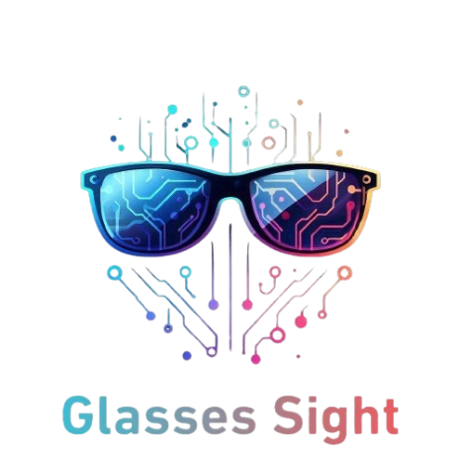
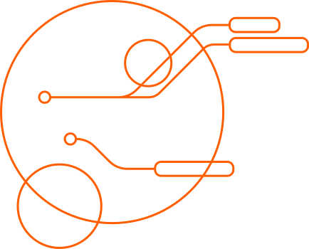
"THE ONLY THING WORSE THAN BEING BLIND IS HAVING SIGHT BUT NO VISION."

Slide 2



MADE BY
OMAR AHMED FAWZY

Slide 3

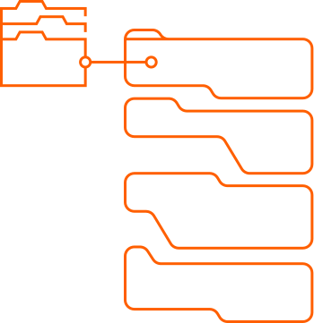
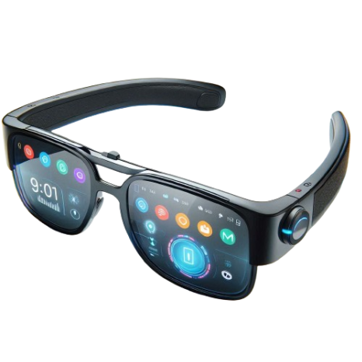

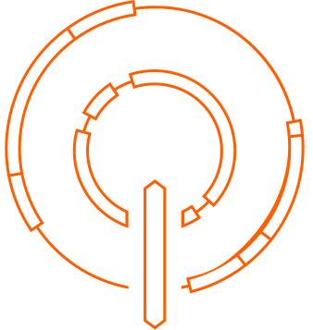
EMPOWERING THE VISUALLY IMPAIRED
REVOLUTIONIZING ACCESSIBILITY IN EDUCATION AND BEYOND

Slide 4
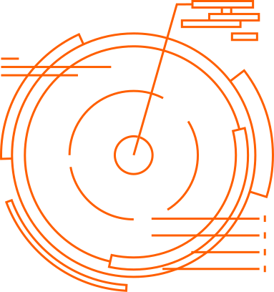

Introduction
0.0
Objective: Empower visually impaired individuals through innovative technology.
01
Enhanced Education: Access to printed text materials in real-time.
02
Facilitated Communication: Convert printed text into audio in multiple languages.
03
Promoted Independence: Foster autonomy in daily tasks and navigation.
0.1
Vision: Create a world where visual impairment doesn't limit access to education, communication, or independent living.

Slide 5

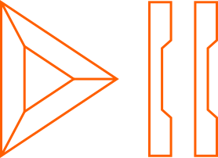
Text-to-Speech Conversion: Implement technology that scans and converts written text into audio, making reading accessible for visually impaired users.
Real-Time Translation: Develop features that translate text from English to other languages, breaking down language barriers and providing a multilingual reading experience.
User-Friendly Design: Ensure the glasses are comfortable, easy to use, and aesthetically pleasing, encouraging widespread adoption and consistent use.
High Accuracy and Efficiency: Utilize advanced technologies like OCR, gTTS, and Google Translation API to achieve high accuracy in text detection and conversion.
Portable and Durable: Create a portable device with long-lasting battery life, suitable for everyday use in various environments, including schools and universities.
SPECIFIC GOALS OF THE GLASSES SIGHT PROJECT.

Slide 6

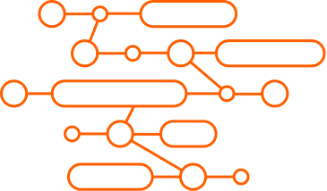

STATISTICS ON VISUAL IMPAIRMENT.
Global Prevalence: Over 2.2 billion people worldwide have a vision impairment or blindness.
Regional Focus - In Egypt there were around 7 million visually impaired people in 2022, with 0.57 million totally blind and 4.7 million with residual vision.
Educational Impact: A significant percentage of visually impaired individuals lack access to quality education, limiting their opportunities for personal and professional growth.

Slide 7
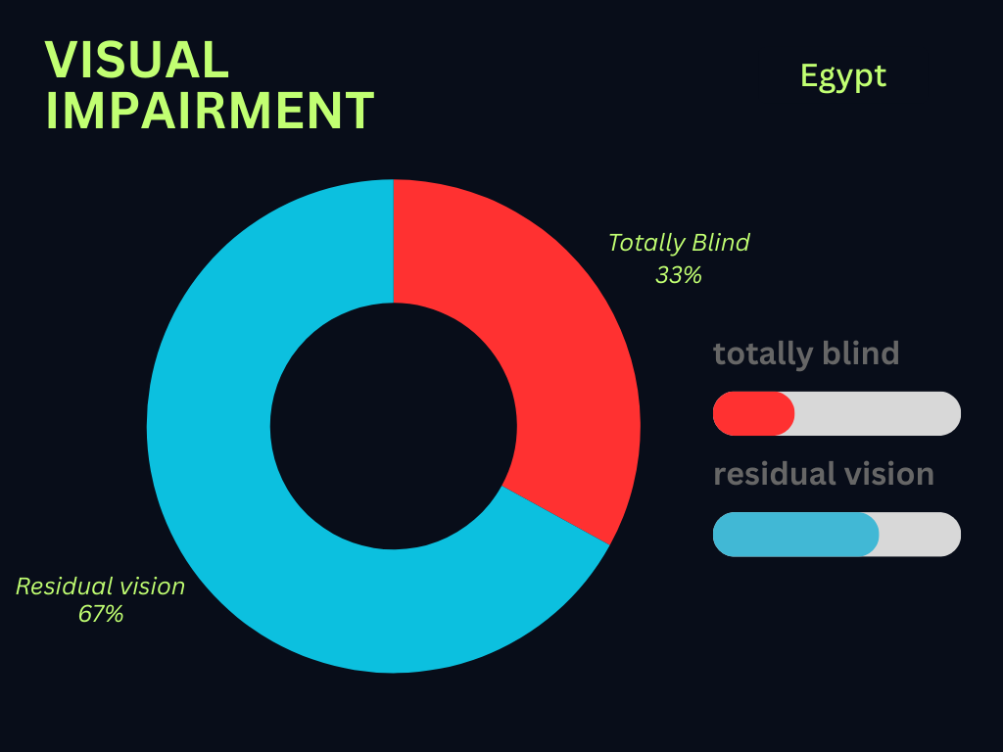
VISUALS:

Slide 8

Braille: Limited availability of Braille books and materials; not all visually impaired individuals are proficient in Braille.
Screen Readers: Dependence on electronic devices; limited to digital content.
Magnifying Devices: Useful for individuals with low vision but not practical for those who are completely blind.
Voice Assistants: Limited in functionality; cannot read printed text or provide translations.
OVERVIEW OF EXISTING SOLUTIONS AND THEIR LIMITATIONS

Slide 9

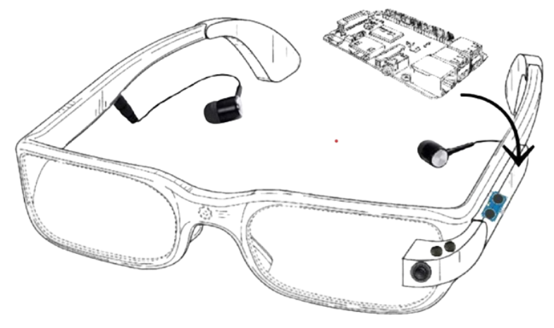
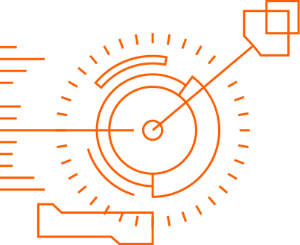
DESIGN GOAAL

Slide 10
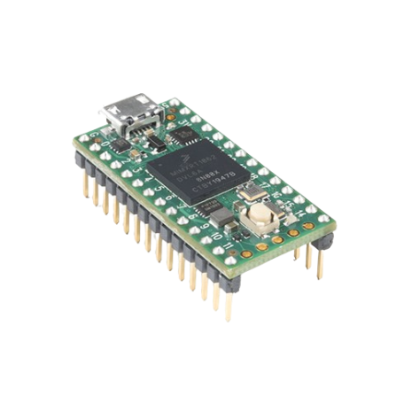

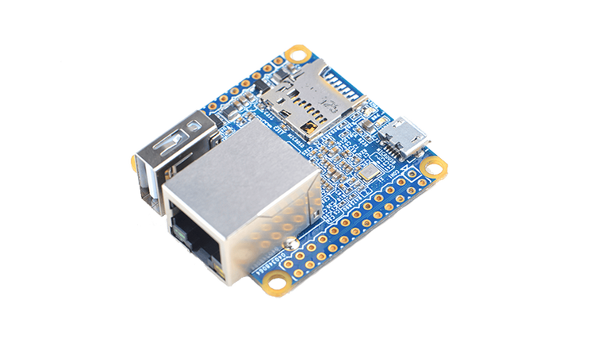
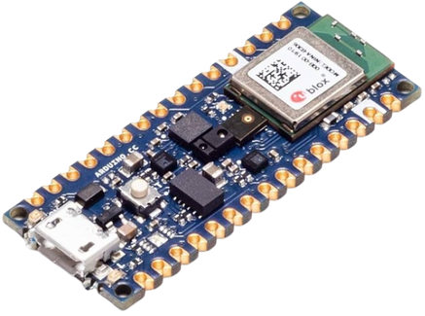
Raspberry pi alternatives
Arduino Nano 33 BLE Sense
NanoPi Neo
Teensy 4.0

Slide 11

PRODUCT ARCHITECTURE & COMPONENTS

Slide 12

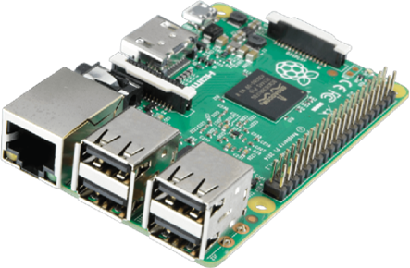
RAPBERRY PI 3B+
Raspberry Pi 3b+ used for many purposes such as education, coding, and building hardware projects. It is the main component of the project. It used as a low-cost embedded system to control and connect all of the components together.

Slide 13
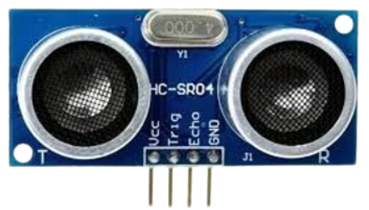
ULTRASONIC SENSORS
The purpose of ultrasonic sensors is to measure the distance using ultrasonic waves. Ultrasonic sensors emit the ultrasonic waves and receive back the reflected. So, by this time the ultrasonic sensor will measure the distance to the object. It can sense from 2-400 cm

Slide 14
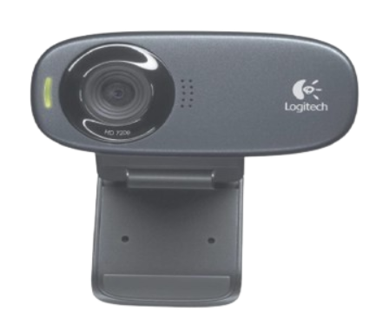
WEBCAM
The webcam has a view angle of 60°with a fixed focus. It can capture images with maximum resolutions of 1289 x 720 pixels. It is compatible with most operating systems platforms such as Linux, Windows, and MacOS. It has a USB port and a built-in mono mic.

Slide 15
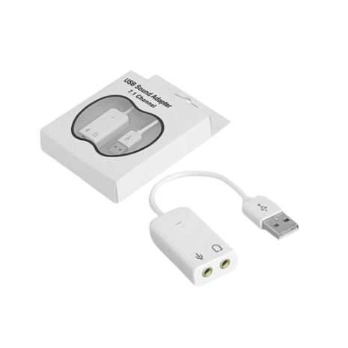
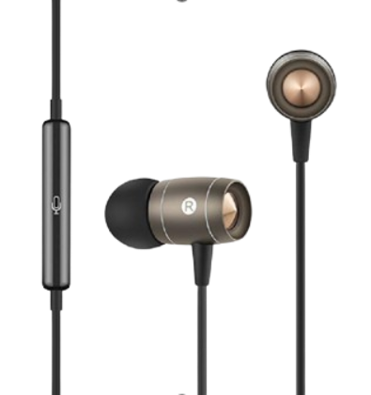
HEADPHONES
USB SOUND ADAPTER
The headphones will be used to help the user listen to the text that is been converted to audio after it is been captured by the camera
A USB sound adapter with 7.1 channel capability can significantly enhance the audio experience on a Raspberry Pi 3B+

Slide 16
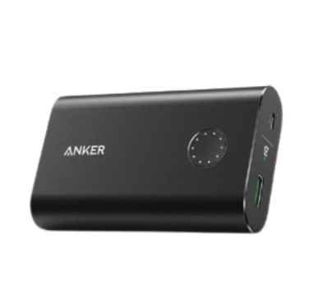
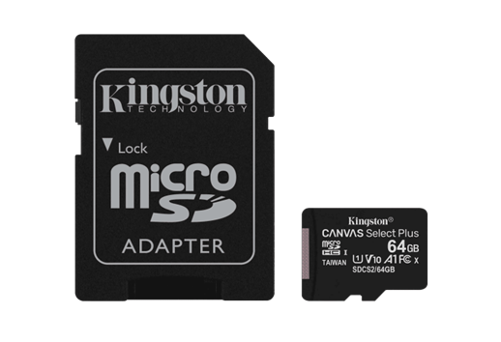
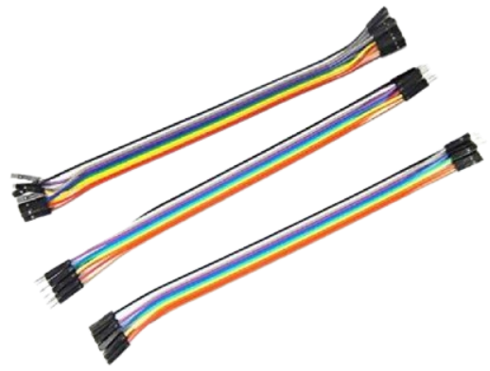
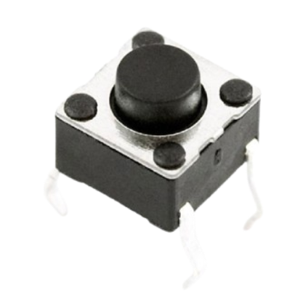
POWER BANK CHARGER
SD CARD
JUMPER WIRES
BUTTONS

Slide 17
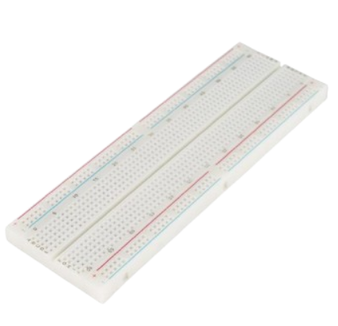
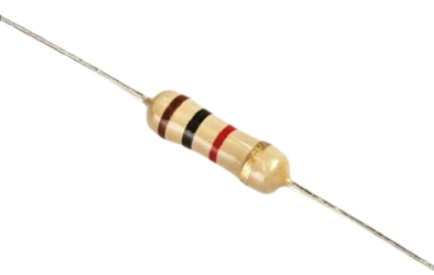
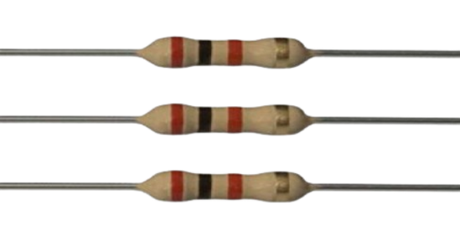

RESISTOR 1K Ω
BREADBOARD
RESISTOR 2KΩ
GLASSES FRAME

Slide 18
INSTALLING THE OPERATING SYSTEM
1
6
Download Raspberry Pi Imager
Choose the Storage
2
7
Install Raspberry Pi Imager
Write the OS
3
8
Prepare the MicroSD Card
Insert the SD Card into the RP3B+
4
9
Run Raspberry Pi Imager:
Power Up the Raspberry Pi
5
10
Select the OS
Initial Setup

Slide 19
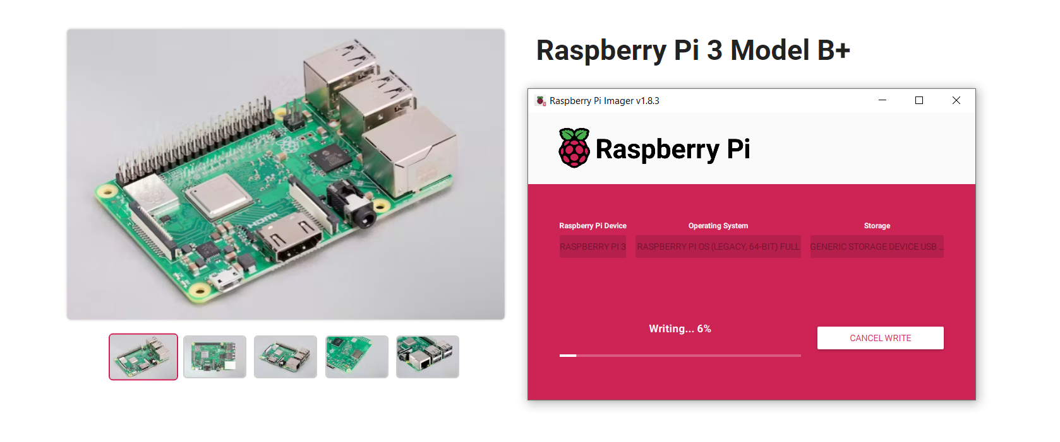
INSTALLING THE OPERATING SYSTEM

Slide 20
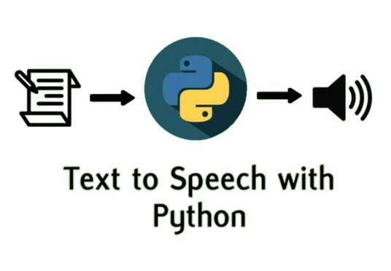


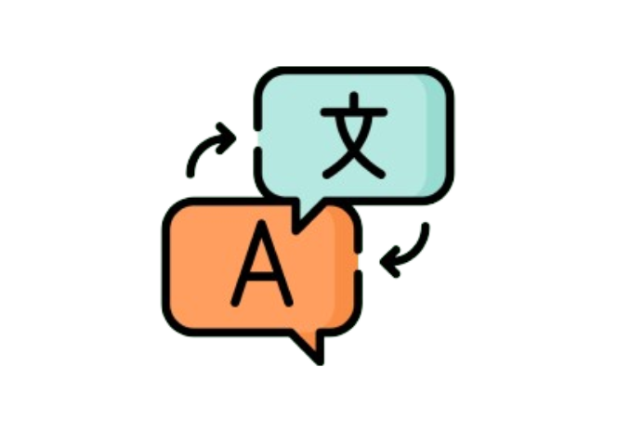
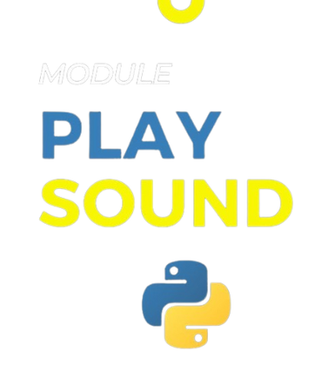

INSTALLING ALL NECESSARY DEPENDENCIES

Slide 21
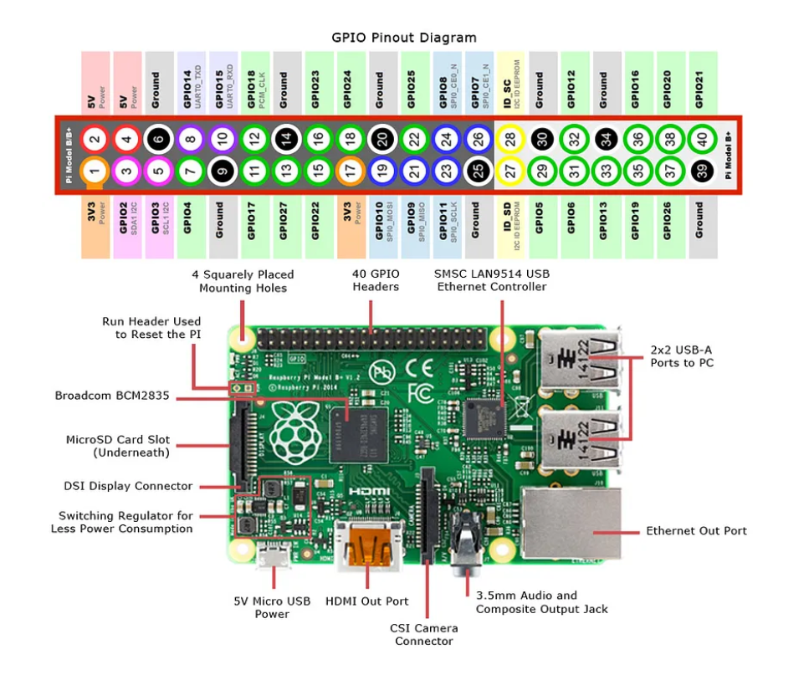
GPIO PINS

Slide 22
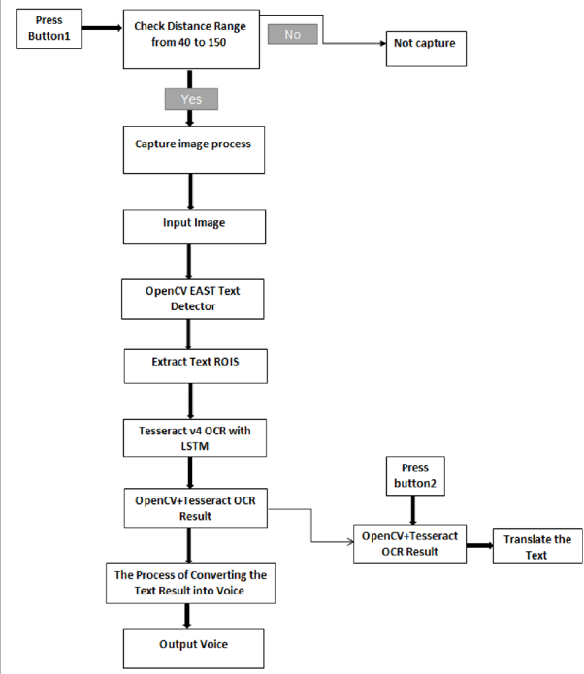
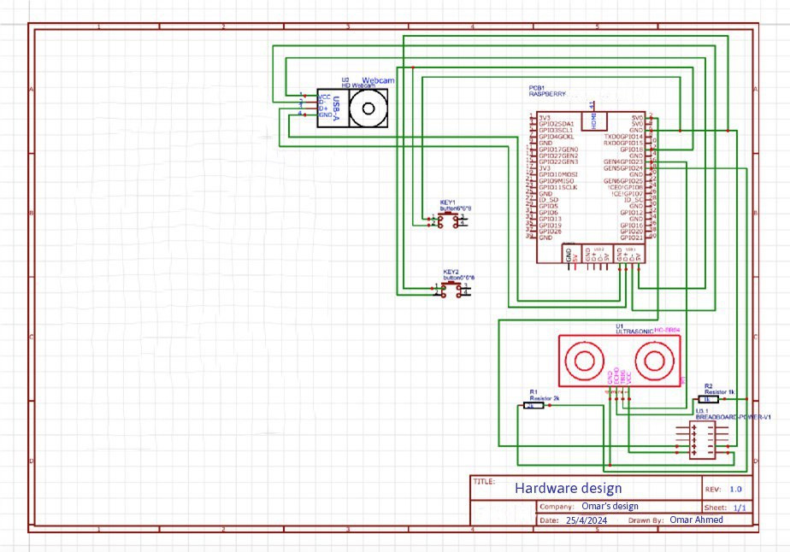
DIAGRAMS
*
*
Hardware Diagram
Software Diagram

Slide 23
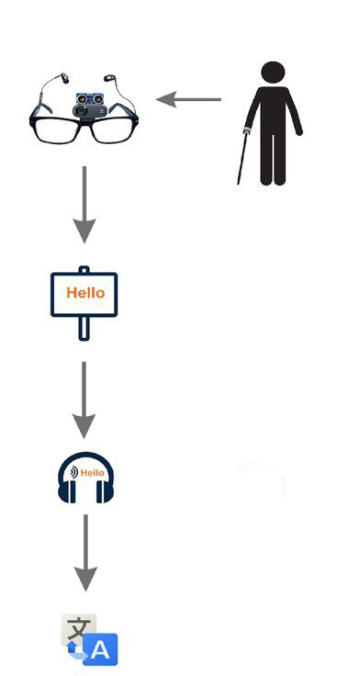
SUMMARY
The smart glasses, equipped with advanced technology, cater specifically to visually impaired individuals. Through voice-based interaction, users can seamlessly communicate with the glasses. Audio output capabilities enhance the overall experience, while built-in translation features bridge language barriers. These innovative glasses empower users by providing a holistic solution for accessibility.

Slide 24
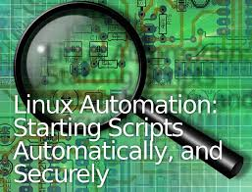
RUNNING SCRIPT
Connect the Button to the Raspberry Pi.
Install Required Libraries.
Create a Python Script to Detect Button Press.
Run the Button Listener Script.
Add Script to Run on Boot or Create a service file.
WITH THIS SETUP, YOUR RASPBERRY PI WILL RUN BUTTON_LISTENER.PY ON STARTUP, AND THE SCRIPT WILL LISTEN FOR THE BUTTON PRESS TO EXECUTE SCRIPT.PY

Slide 25
Advanced Communication Tools
Health Monitoring
Enhanced Visual Assistance
Voice Assistant Integration
Entertainment and Media
Safety and Security Features
Battery and Power Management
IoT Integration
Virtual Meetings
FUTUER FEATURES GOALS

Slide 26
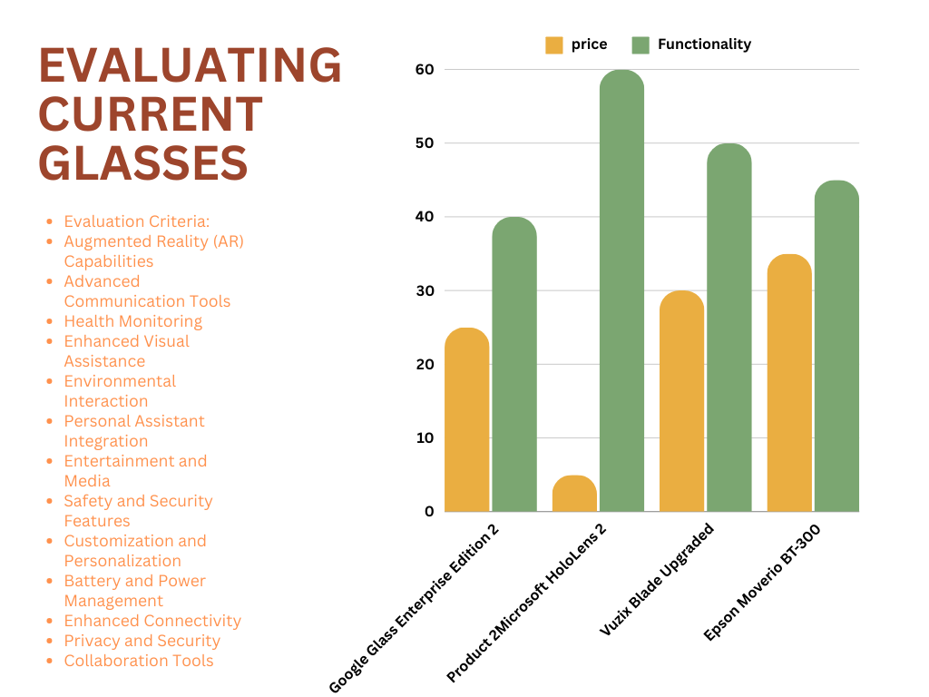

Slide 27

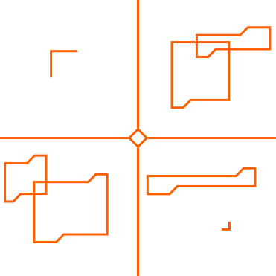
Thank you for your time

